Slide 1
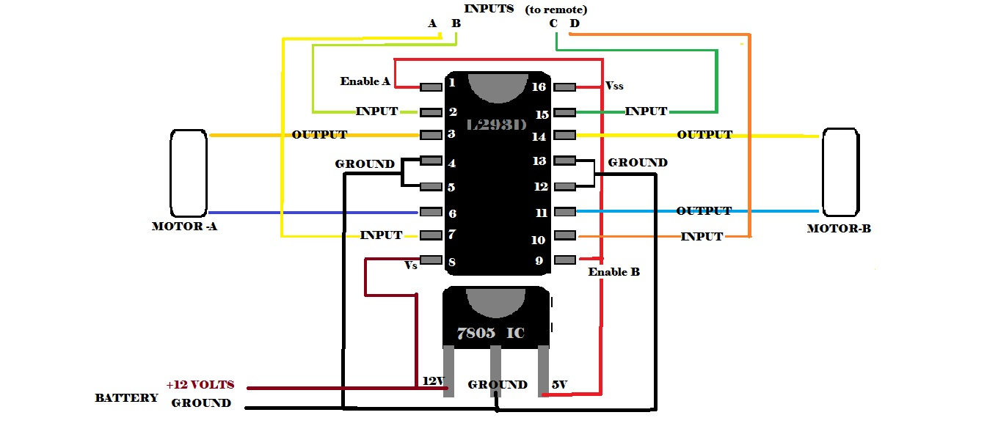
XLR8
Electrical Session
Learn to make the brain of your bot
By
-Robotics club

Slide 2
How to run the motors??
4 motors using just 1 remote !!

Slide 3
Let’s start with something
useful and simple….

Slide 4
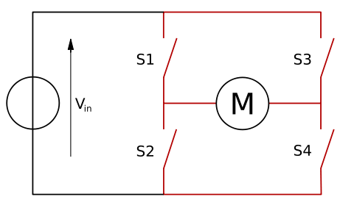
H bridge
An H bridge is an electronic circuit that enables a voltage to be applied across a load in either direction.
See it for yourself in which direction current goes when S1 and S4 are on and when S2 and S3 are on.
Using such a circuit, you can supply current to the motor in two directions!!!!

Slide 5
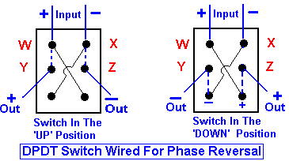
Make your own Remote- DPDT Switches
2 DPDT switches used for 2 Motor each.

Slide 6
Our Main task is to build a circuit that will enable us to drive the motors through switches wirelessly.
For this we would need some Electrical Components
RF Circuit: A Circuit to enable the wireless communication between our Remote and the car
L293D IC: Something to drive the motor as per command
As we would see the above components would work only in some specific voltage range, we would need to build a circuit to convert the DC voltage from a battery to the voltage in specific range

Slide 7
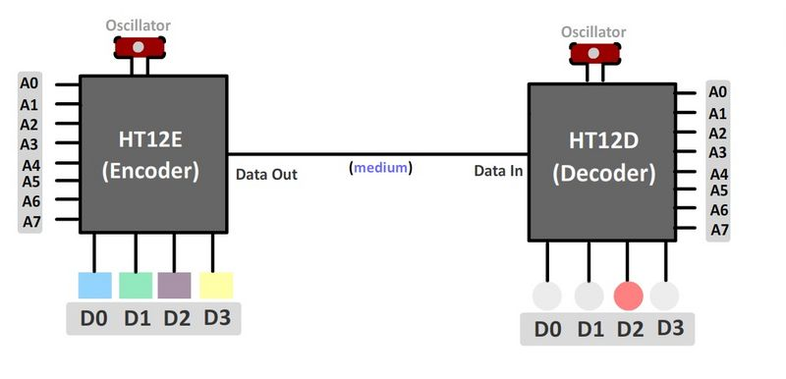
Radio Frequency Circuit (RF Circuit)
Used in remote controlled robots and implements wireless communication.

Slide 8
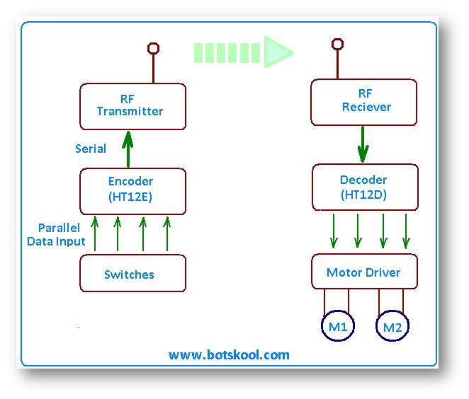
How it works???
Your input is 4 lows/highs in terms of voltage.
Input is encoded sent to the transmitter.
Signal is received by the receiver and decoded.
This input is then sent to Motor driver (here L293D)
More about L293d to come in few minutes!!!
L293D drives the motor according to the input.

Slide 9
How to implement it??
Connect the input from DPDT switches to channels in the encoder circuit.
Connect the output pins in decoder circuit to corresponding pins of L293D.
Input (from DPDT switches)
Transceiver
L293D
Receiver

Slide 10
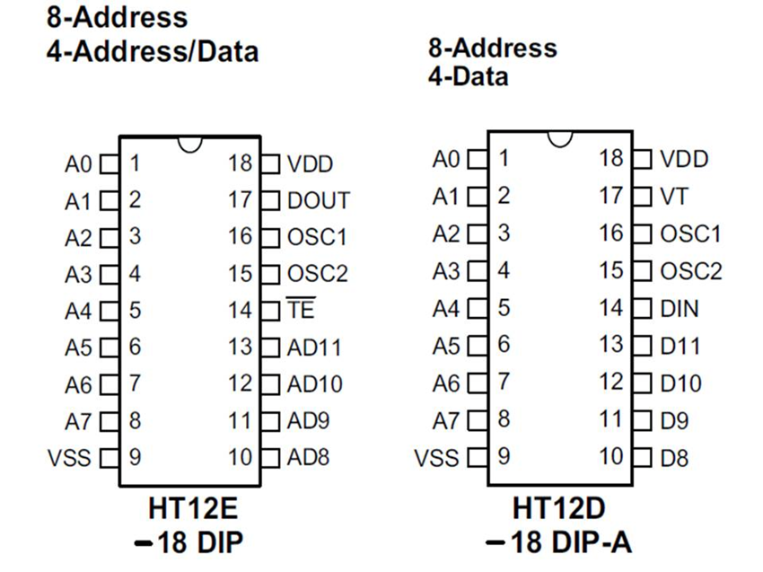
Interference due to Same Frequency
Solution is simple: Change your address bits (both in Encoder and Decoder)
Two Encoder and Decoders talk to each other only if they have same address bit combination.
Your address bit scombination is like your password!!!

Slide 11
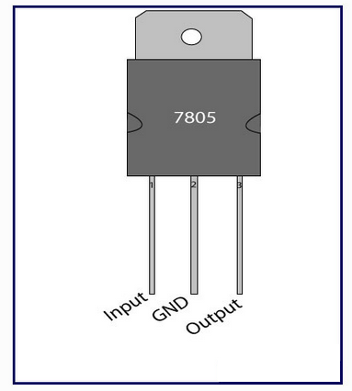

7805 IC
Three terminal positive voltage regulator.
It is used to convert 12V supplied by the battery to 5V.
Don’t forget to attach heat sink as remaining voltage is wasted as heat.
Very important component in a circuit as all RF circuits (to be introduced after few slides) and sensors work on 5 Volts.
1
2
3

Slide 12
As we would see later our car would receives a signal of only of 5 volts or less than 5volts. But our motor needs around > 9V to run and about 12 V to run efficiently. So how do we run motors of 12 Volts???
We need a circuit that acts as a switch
i.e. when it gets 5volt signal it switches 12 volts to the motors.

Slide 13
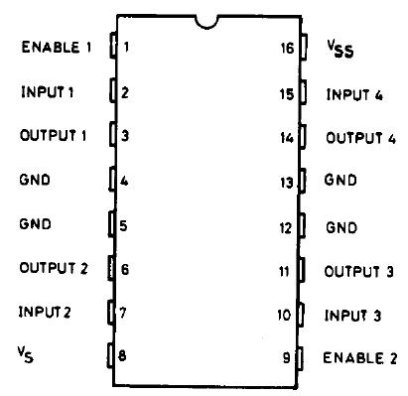
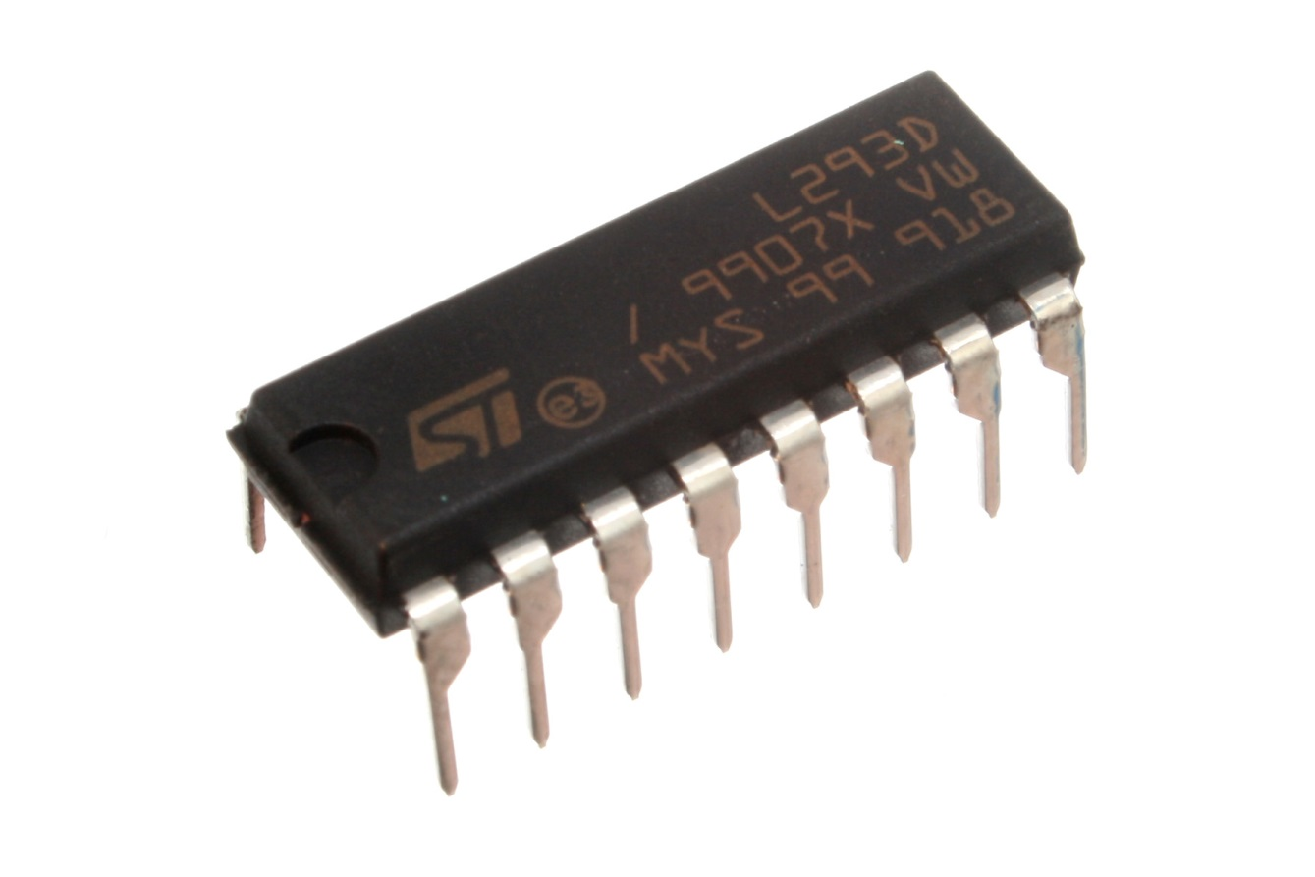
L293D – Motor Driver IC

Slide 14
B
H-bridge is implemented inside the L293D

Slide 15
When a button is pressed the information is encoded and converted into a signal.
The transmitter sends a signal in the range 5 volts.
At the Receiver the voltage signal gets decoded again , and the information is received.
The output from the receiver is also of 5V finally.

Slide 16
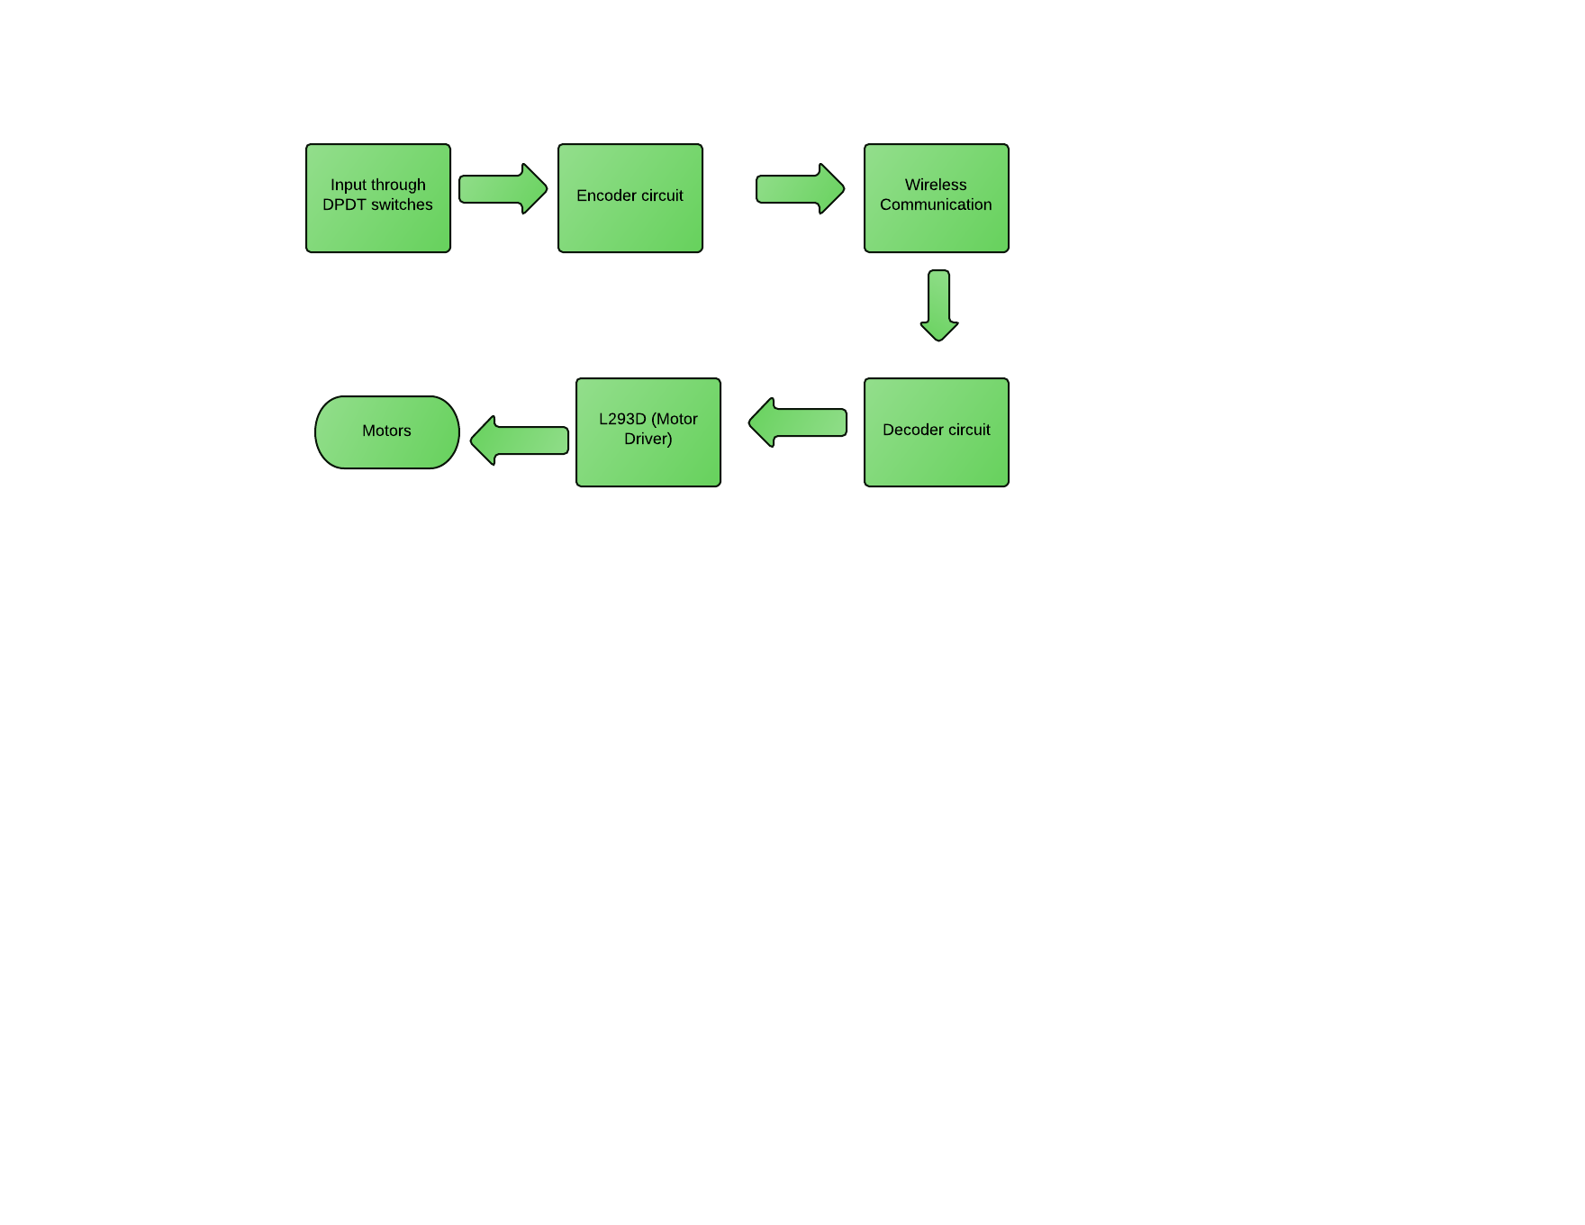
We have our answers now ☺ ☺

Slide 17
Any Doubts ???

Slide 18
Thanks !! And Keep up the Enthu!!
Yash: 9967164641
Riddhish: 9769472731
Rishabh: 9892314375
Ankita: 9773619340

